Slide 1
Super Test
Group: I3
Filipe Lagrenade, Sanjay Williams, JIA SON Pow, Isaac Ellis

Slide 2
Problems

Slide 3
Problem #1 - No Standalone Assessment Software
Currently all Assessments run through downloading files from blackboard and uploading solutions/handwritten
Students have to ask questions manually
Students have to save files manually
No way to lock students out of their files after test completion

Slide 4
Problem #2 - Loss of Data
Currently if students are sitting an assessment and something goes wrong such as their computer crashing they will:
Lose all of their unsaved local data
Lose a lot of time from their assessment
Potentially fail

Slide 5
Problem #3 - Students asking questions
Due to the size of the new super lab, it can be hard to get the attention of the invigilators
This means a lot of wasted time for the students which could affect their final score

Slide 6
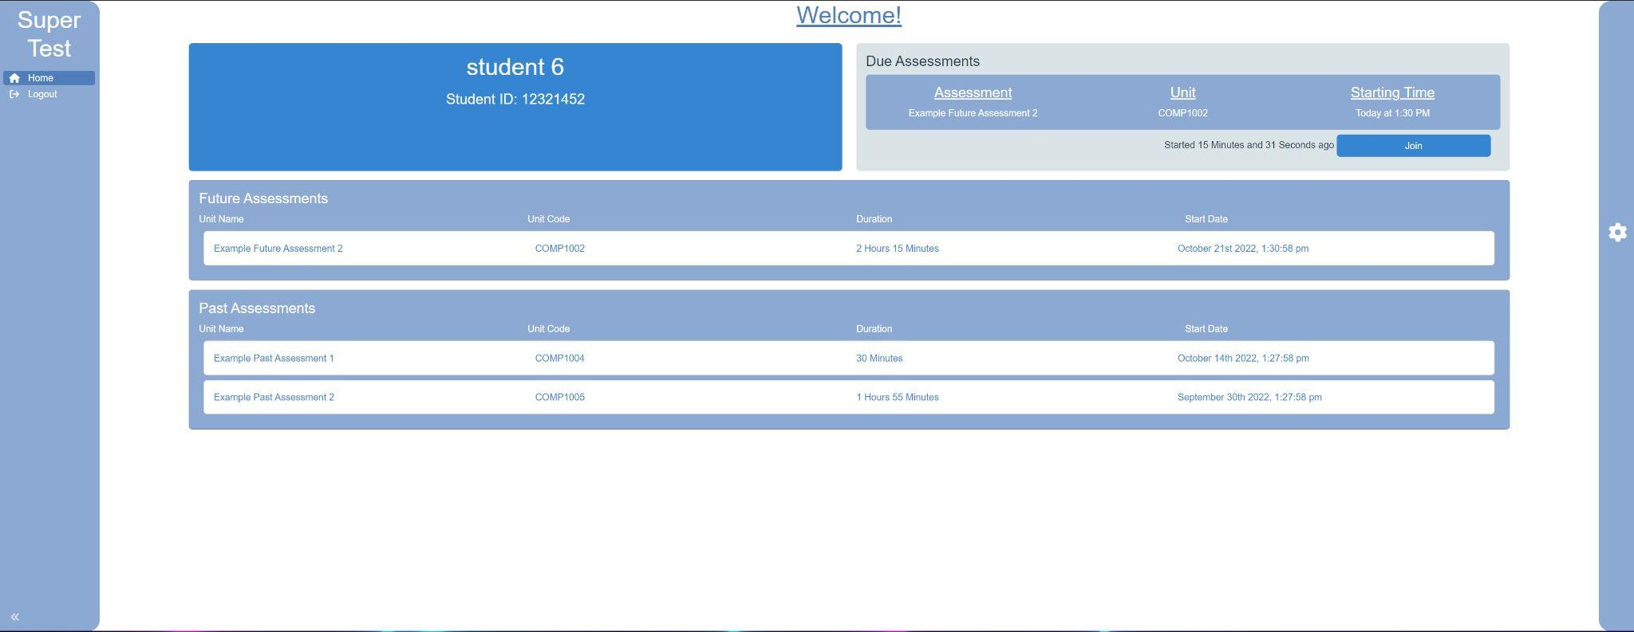
Solution #1 - SuperTest
Provides a solution which has:
All assessments, past, current and future in-built into the software
Assessment files are made available immediately once the assessment time has started so that no time is lost downloading/uploading files
Easy-to-use question asking module to assist the students in getting assistance as fast as possible

Slide 7
Challenges
Notes:
Thank you Filipe.
During our two semesters the group faced and solved many challenges.
For this section of the presentation we would like to highlight several of our favourite challenges.
Challenges that best display the care and technical acumen group I3 applied to the project

Slide 8






Challenge #1: File Syncing
Build a system that can sync a students test documents during an assessment.
From the student client to the backend server
The student client is a linux machine
Solution must be reliable and fast
* all file types are supported
Notes:
Earlier in the presentation Filipe hinted to our first major problem. “File Syncing”.
How exactly are we going to sync across the work of each student during an assessment.
For this challenge we first had to break down our requirements.
Firstly the files are to be synced from a client on the students machine, to a server. And that student client has to run on linux machine.
Next we had to step inside the shoes of our users, which was easy because we’re also students. During an assessment the syncing of files has to work well, every time. When it says it saved it better be saved, when you press save it better save. Moreover seasoned lecturers and tutors of the audience will also know the pain failing assessment software and costly resits. For everyone involved assessments are stressful, our software can not be adding to that.
As group we knew what our solution had to be reliable and fast

Slide 9

Solution: Rsync
A linux file transfer utility
Released in 1996
Reliable and Efficient
Notes:
Our solution was rsync.
Rsync is a popular unix utility for transferring files across networks.
It was release in 1996 and has become a staple for systems administrators, programmers and all other IT professionals.
Rsync is a battle tested and reliable tool. Which makes it perfect for our application.
Its also known very efficient, one of the authors Dr Andrew Tridgell wrote several chapters of his PHD thesis on the implementation.

Slide 10
Challenge #2: Rsync - Security
Rsync is used largely by system administrators to transfer files between trusted servers
Rsync transfers files over ssh
It provides two options to authenticate over ssh
Key based authentication
User based authentication
It provides two way to transfer files
Push (push files to server)
Pull (pull files from student client)
Notes:
Once we had picked rsync and started on working on our implementation we ran into our next big challenge.
How do we secure this?
Rsync is used a lot by system administrators to move things around

Slide 11
Option #1: Rsync Pull
Using rsync pull the server would retrieve files from students machines
To authenticate the server must have credentials to ssh to each machine running the student client
This could be implemented by requiring ever student machine to have a universal user or ssh key
Or it the student client could create and share users or ssh keys that it creates
 | Key Auth | User Auth
Push
Pull | A universal key or user if stolen would put all users at risk Creating users and keys dynamically would require the client to have elevated privileges. Which coil lead privilege escalation issues

Slide 12
Option #2: Rsync Push using Key Authentication
Using rsync push the student client would push their files to the server
To authenticate the student client would need a ssh key to access the backend
This ssh key could be dynamically created by the server and sent to the student client for the duration of the assessment
 | Key Auth | User Auth
Push | With an ssh key the user could ssh into the server and compromise the security
Pull | A universal key or user if stolen would put all users at risk Creating users and keys dynamically would require the client to have elevated privileges. Which coil lead privilege escalation issues

Slide 13
Option #3: Rsync Push using User Authentication
Using rsync push the student client would push their files the server
To authenticate the student client would need user credentials to access the server
This user could be dynamically created by the server and sent to the student client for the duration of the assessment
The users privileges can be set so they can only access assigned folders and commands.
 | Key Auth | User Auth
Push | With an ssh key the user could ssh into the server and compromise the security | Users can be created dynamically User privileges can be restricted
Pull | A universal key or user if stolen would put all users at risk Creating users and keys dynamically would require the client to have elevated privileges. Which coil lead privilege escalation issues

Slide 14
Solution #2: How to use rsync securely

Slide 15
Project Requirements
Notes:
Thank you Isaac
During our two semesters we have been able to fulfill many project requirement and unable to fulfill some others as well.
For this section of the presentation we would like to talk in depth about the project requirements that we have met and not met.

Slide 16
Requirements that are still yet to be met
Sign-up (creating new accounts)
Forgot password (password reset)
Edit assessment
Cancel assessment
Notes:
Sign-up - unable to create new accounts, need to be manually added by the system admin.
Password reset - unable to change your password after you have an account on the server, needs to be changed manually by the system admin.
Edit assessment - unable to add students, change files and names after an assessment is added to the server
Cancel - unable to delete the assessment before it begins

Slide 17
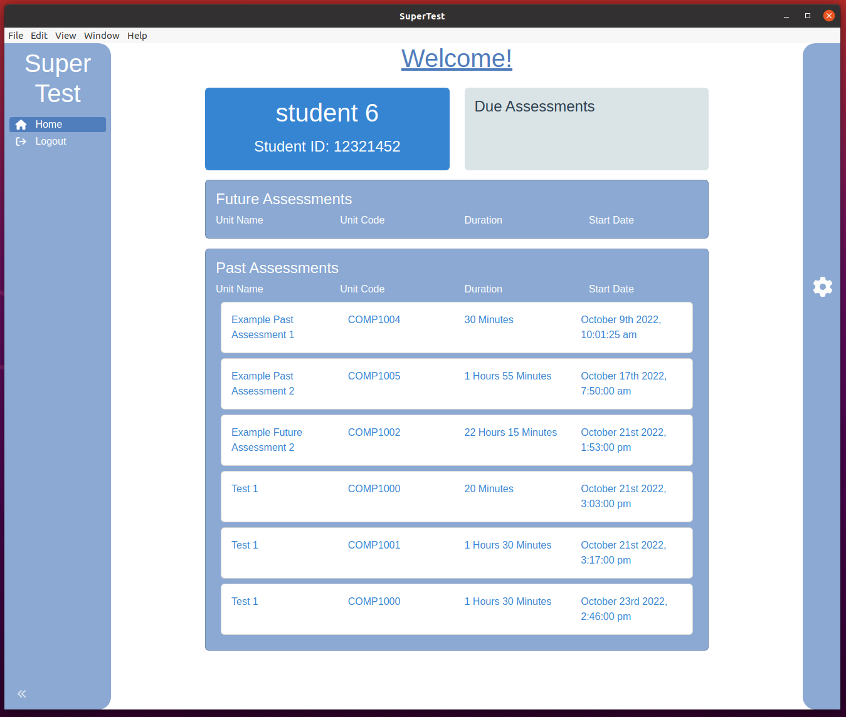
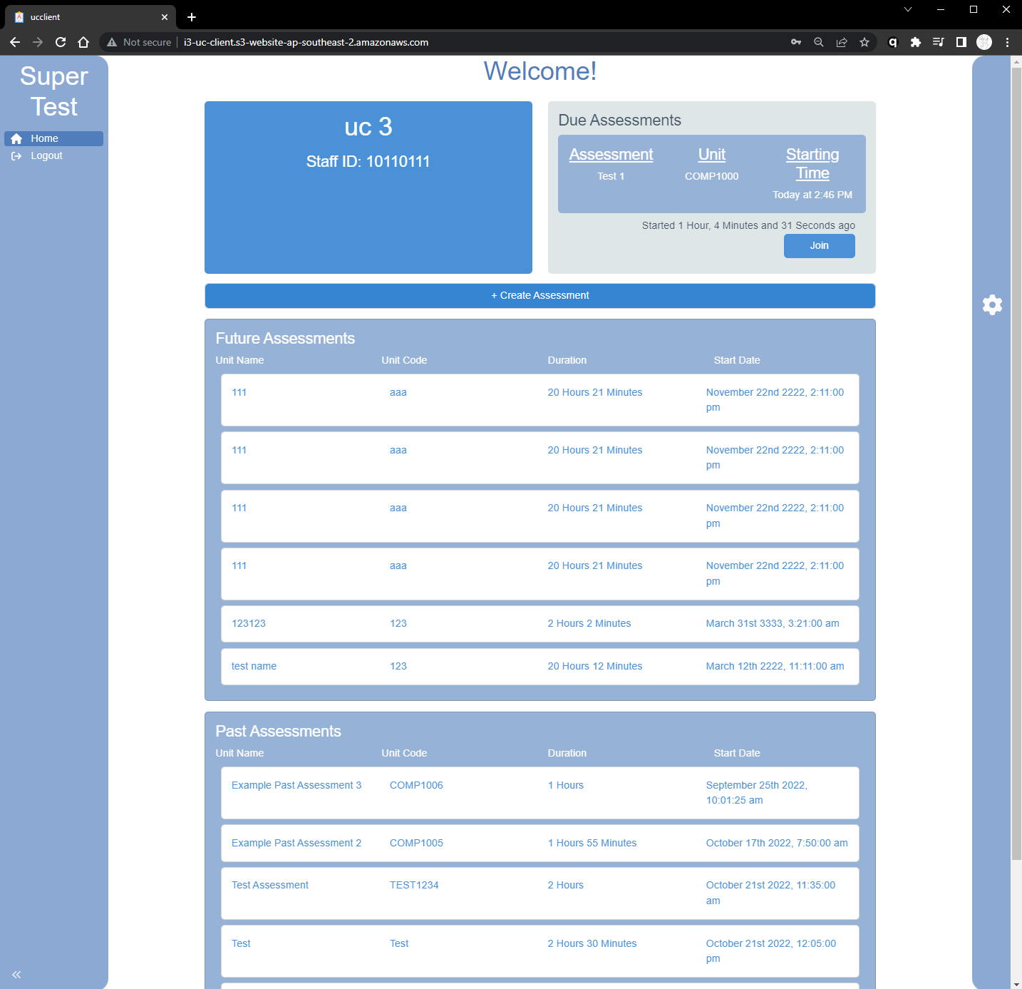
Requirements that are met
Student client dashboard
UC client dashboard
Notes:
Student client dashboard UC client dashboard

Slide 18
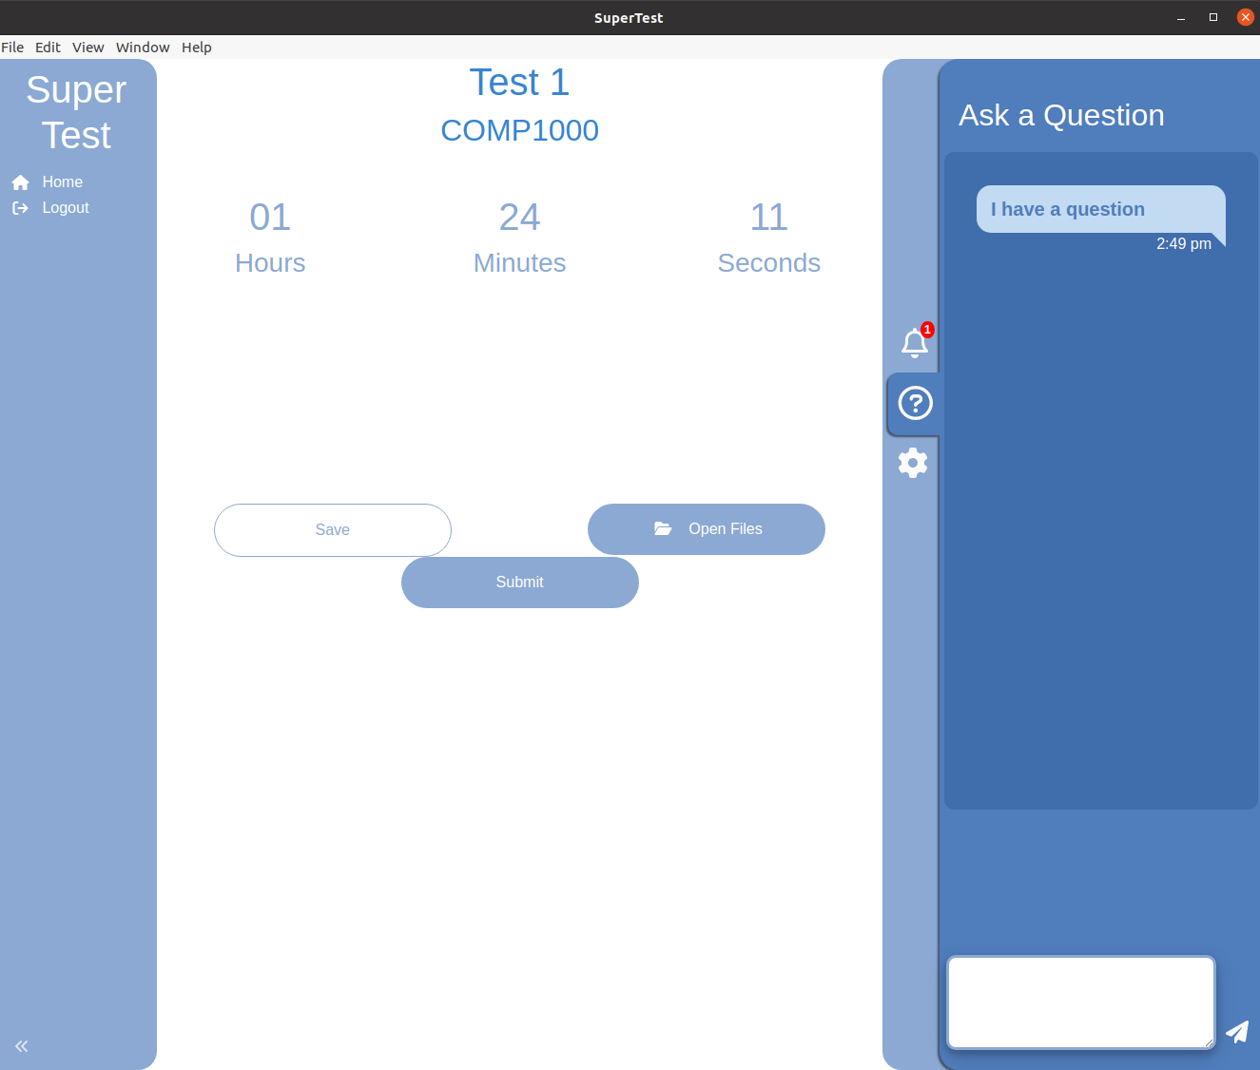
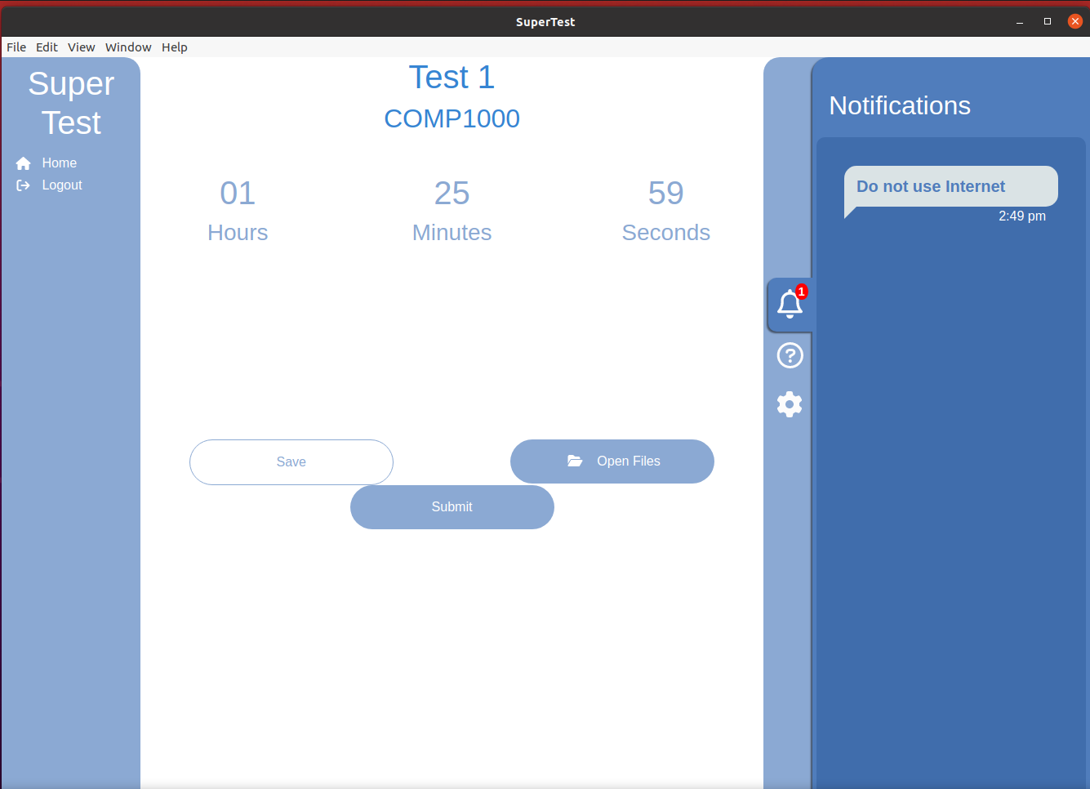
Requirements that are met
Inquiry Tab
Announcement Tab
Student Client
UC Client
Notes:
Inquiry tab - Send inquiry on student client (pop-ups for appearing, reminder after 5 mins of idling), Answer inquiry tab for UC (same thing)
Global announcement tabs - send announcement tab for UC client, pop-up notifications for students

Slide 19
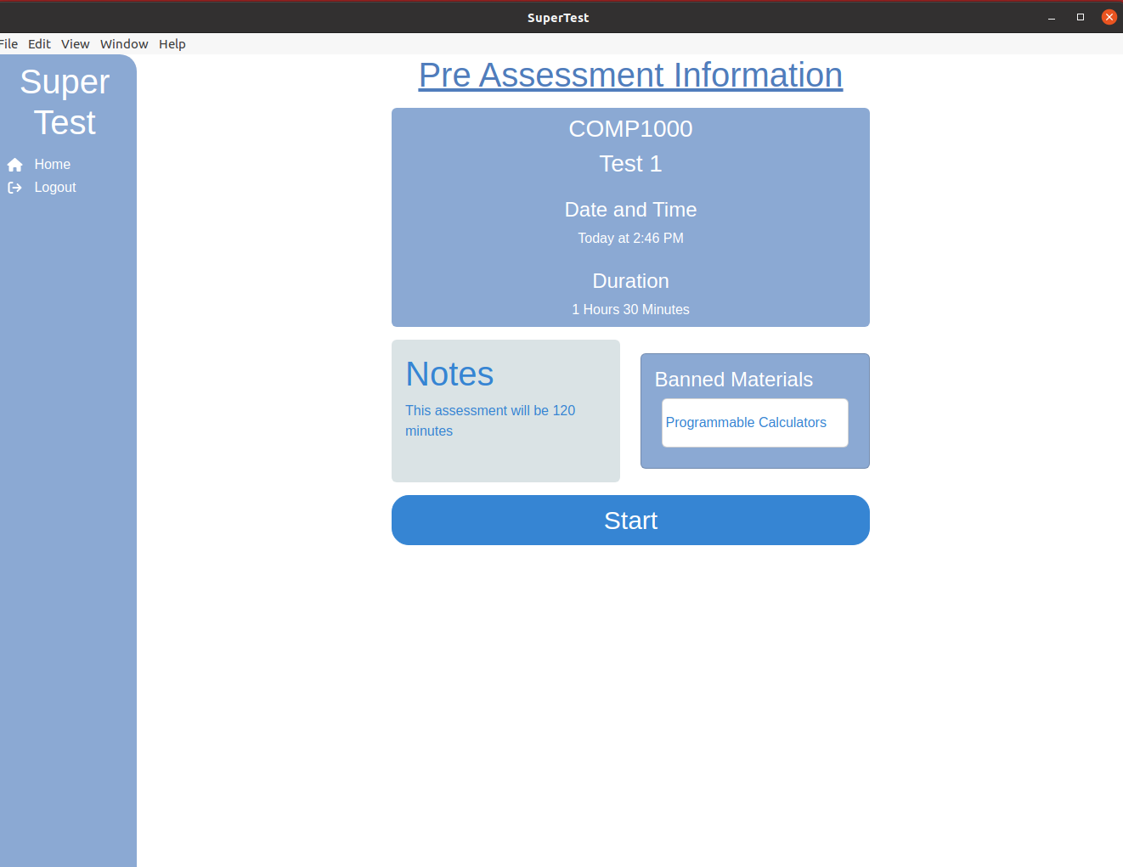
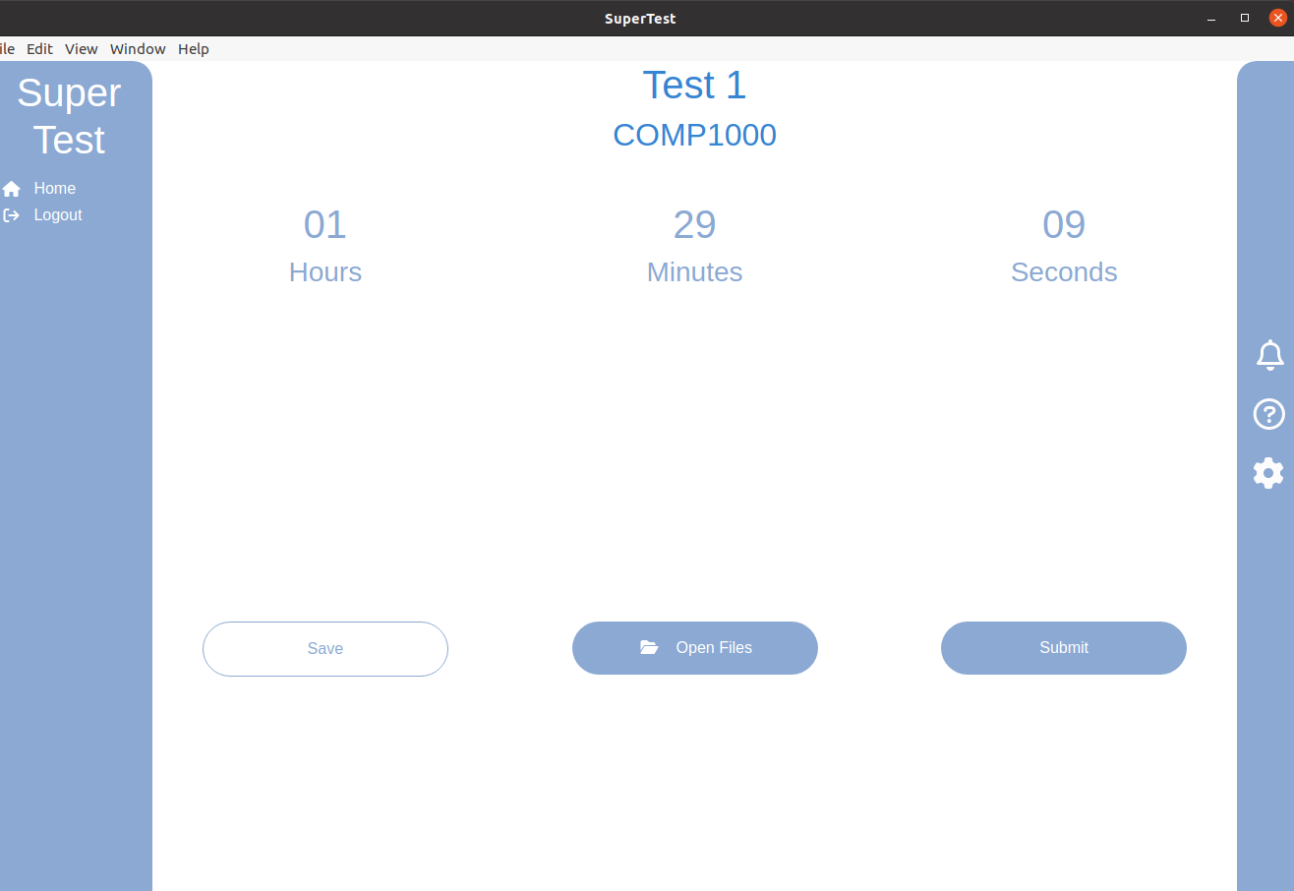
Requirements that are met
Pre-assessment information Join assessment - countdown timer
Notes:
Pre-assessment info - let’s the students know what materials can be used for the assessment
Countdown timer - shows time left for current assessment for both students and UCs

Slide 20
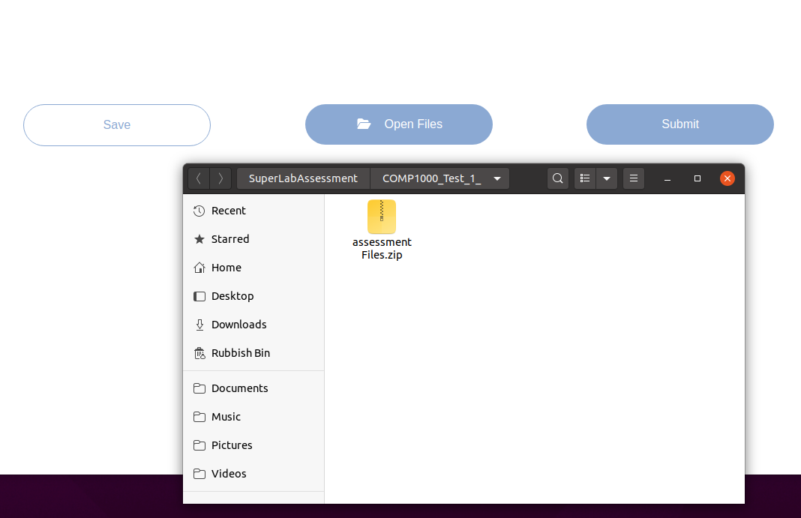
Requirements that are met
Create assessment File Access
Notes:
Create assessment - the UC is able to input all the necessary information that would be essential for a new assessment.
Upload/download files - the student will be able to add what they need into the folder, they are also able to save their progress manually via the save button, their work will also be saved automatically in 5 minute periods by the Rsync modules implemented.

Slide 21
Why should you care about our project?

Slide 22
Questions

